Slide 1
Lesson 2: Performance of Control Systems
EC311
Linear Control Systems

Slide 2
Learning Objectives
After this presentation you will be able to:
Explain what constitutes good control system performance.
Identify controlled, uncontrolled, and unstable control system response.
Analyze measurement error in measurement sensors.
Determine sensor response.
Apply significant digits and basic statistics to analyze measurements.

Slide 3
Control System Performance
System control variable changes over time so error changes with time.
E(t) = R - C(t)
Where E(t) = error as a function of time
R = setpoint (reference) value
C(t) = control variable as a function of time
Determine performance criteria for adequate control system performance. System should maintain desired output as closely as possible when subjected to disturbances and other changes

Slide 4
Control System Objectives
1.) System error minimized. E(t) = 0 after changes or disturbances after some finite time.
2.) Control variable, c(t), stable after changes or disturbances after some finite time interval
Stability Types
Steady-state regulation : E(t) = 0 or within tolerances
Transient regulation - how does system perform under
change in reference (tracking)

Slide 5
Types of System Response
3
2
1
1.) Uncontrolled process
2.) Process control activated
3.) Unstable system

Slide 6
Types of System Response
Damped response
t_{d}
Setpoint
Change
Control variable requires time to reach final value

Slide 7
Types of System Response-Transient Responses
Setpoint Change

Slide 8
Types of System Response-Transient Responses
Disturbance Rejection

Slide 9
Analog Measurement Errors and Control Systems
Amount of error determines system accuracy
Determing accuracy
Percent of Full Scale (FS)
FS∙(%/100)
Percent of Span
Span=max-min
Span∙(%/100)
Percent of Reading
Reading∙(%/100)
Accuracy ± 5% FS =10V
E=10V(± 5%/100)
E= ± 0.5 V
Accuracy ± 3%
min=20, max= 50 psi
E=(50-20)(± 3%/100)
E= ± 0.9 psi
Accuracy ± 2%
Reading = 2 V
E=(2V)(± 2%/100)
E= ± 0.04 V
Measured Value
Reading ± Value
100 psi
± 2 psi

Slide 10
System Accuracy And Cumulative Error
Subsystem errors accumulate and determine accuracy limits. Consider a measurement system
C_{m}
K±ΔK
G±ΔG
V±ΔV
Sensor
Sensor amplifier
K = sensor gain
G = amplifier gain
V = sensor output voltage,
ΔG, ΔV, ΔK uncertainties in measurement
What is magnitude of ΔV?

Slide 11
System Accuracy And Cumulative Error
Output
Input
With no uncertainty: V = K∙G∙C_{m}
With uncertainty V±ΔV = (K±ΔK)∙(G±ΔG)∙C_{m}
Multiple out and simplify to get:
Component
Tolerance/100

Slide 12
Combining Errors
Use Root-Mean-Square (RMS) or Root Sum Square (RSS)
This relationship works on all formulas that include only multiplication and division.
Notes:

Slide 13
Cumulative Error Example
Example 2-1: Determine the RMS error (uncertainty) of the OP AMP circuit shown. The resistors R_{f} and R_{in} have tolerances of 5%. The input voltage V_{in} has a measurement tolerance of 2%.
Determine uncertainty from tolerances
ANS

Slide 14
Sensor Characteristics
Sensitivity - Change in output for change in input. Equals the slope of I/O curve in linear device.
Hysteresis - output different for increasing or
decreasing input.
Resolution - Smallest measurement a sensor can make.
Linearity - How close is the I/O relationship to a straight line.
C_{m} = m∙C + C₀
Where C = control variable
m = slope
C₀ = offset (y intercept)
C_{m} = sensor output

Slide 15
Sensor Sensitivity Example
Find a sensors sensitivity using data two points. Use point-slope equations to find line parameters
Where:
Example 2-2: Temperature sensor has a linear resistance change of 100 to 195 ohms as temperature changes from 20 - 120 C. Find the sensor I/O relationship
Define points : (x₁, y₁) = (20 C, 100 Ω) x = input y = output
(x₂, y₂) = (120 C, 195 Ω)

Slide 16
Sensor Sensitivity Example (2)
Compute the slope and the equations:
ANS
Can plot above equation to check results

Slide 17
Sensor Response
Ideal first-order response-ideal
C_{f}
b_{f}
Measured Control
Variable
C_{i}
b_{i}
No time delay
Time
Step change in the measured variable- instantly changes value.
Practical sensors exhibit a time delay before reaching the new value.

Slide 18
Practical Sensor Response
Let b(t) = sensor response function with respect to time.
Step
Increase
Step
Decrease
b_{i}
b_{f}

Slide 19
Modeling 1st-Order Sensor Response
For step increase:
Where b_{f} = final sensor value
b_{i} = initial sensor value
t = time
τ = time constant of sensor
For step decrease:

Slide 20
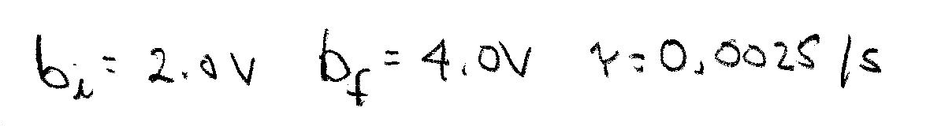
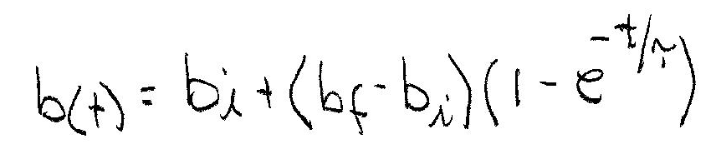
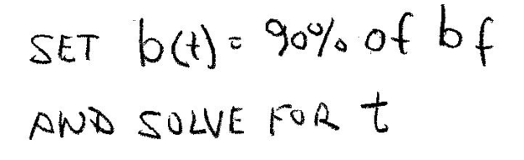
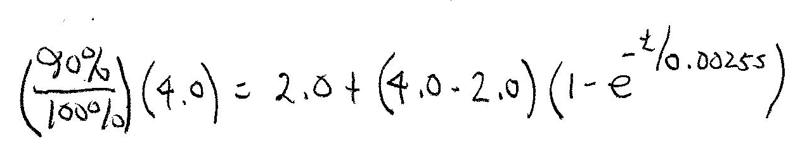
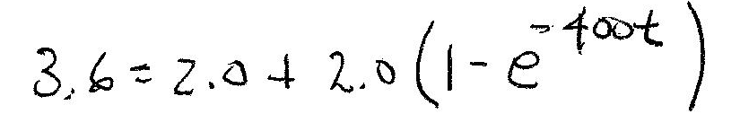
Sensor Response Example 1
Example 2-3: A control loop sensor detects a step increase and has an initial voltage output of b_{i} = 2.0 V Its final output is b_{f} = 4.0 V. It has a time constant of τ = 0.0025 /s. Find the time it takes to reach 90% of its final value.

Slide 21
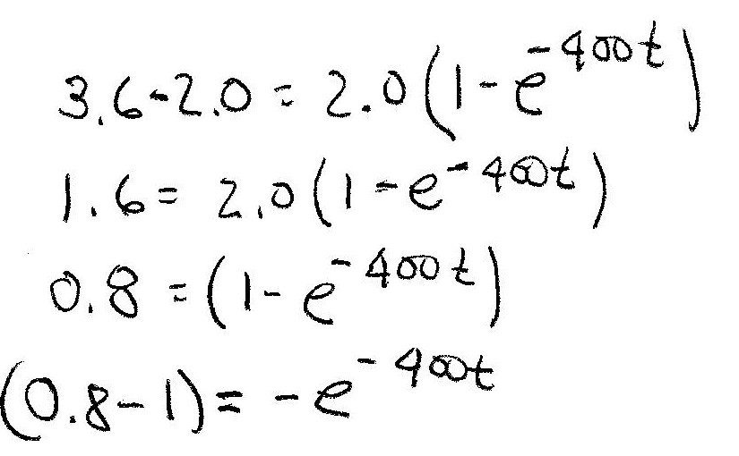
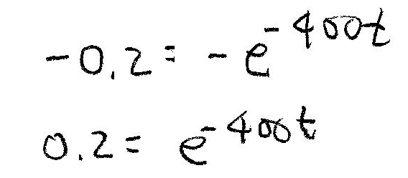
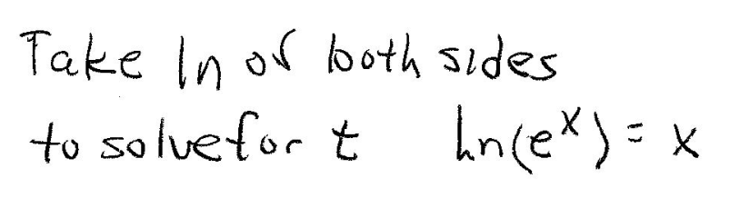
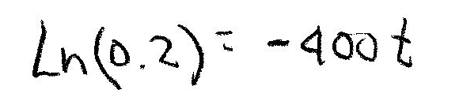
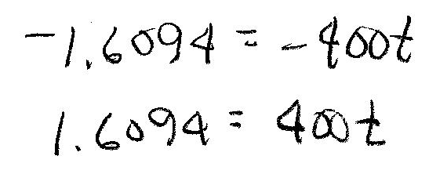
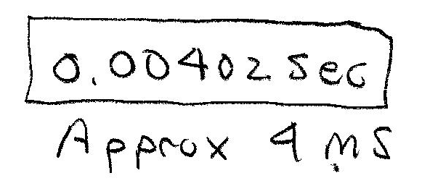
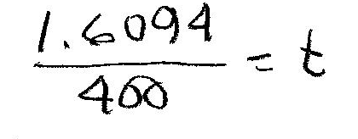
Example 2-3 Continued (2)
Complete the calculations to find t

Slide 22
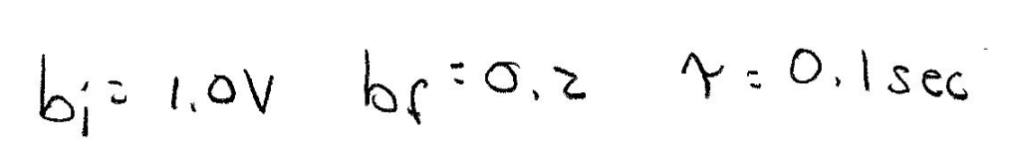
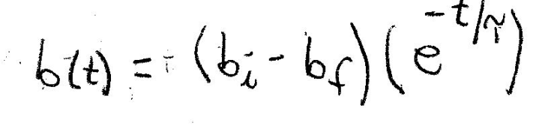
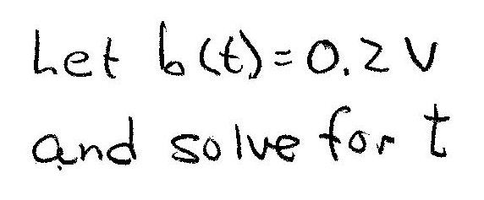
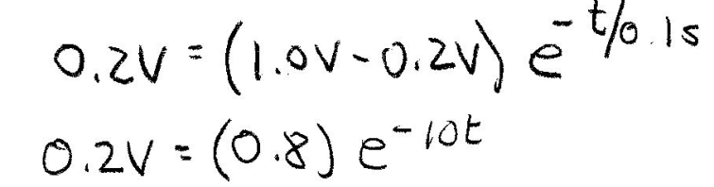
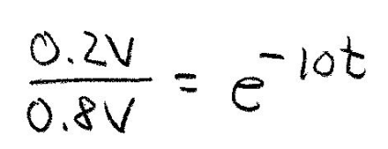
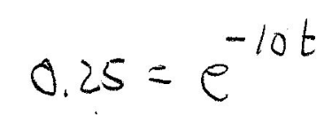
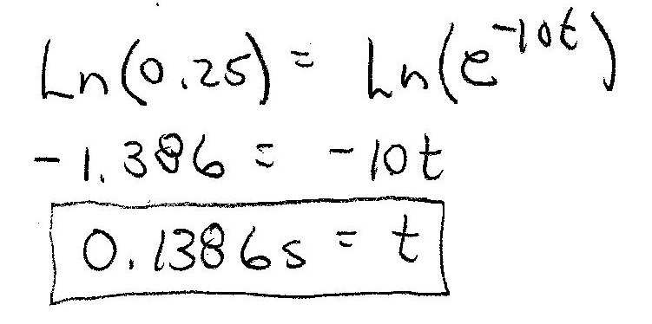
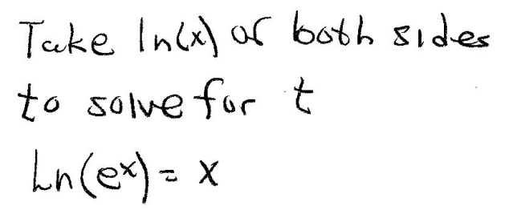
Sensor Response Example 2
Example 2-4: A sensor with a first order response characteristic has initial output of 1.0 V. How long does it take to decrease to 0.2 V if the time constant of the sensor is 0.1/s.

Slide 23
Significant Digits in Instrumentation and Control
Significant Digits In Measurement
Readable output of instruments
Resolution of sensors and transducers
Calculations Using Measurements
Truncate calculator answers to match significant digits of measurements and readings,

Slide 24
Significant Digit Examples
Example 2-5: Compute power based on the following measured values. Use correct number of significant digits.
3.25 A 3 significant digits
117.8 V 4 significant digits
P = V∙I=(3.25 A)∙(117.8 V) = 382.85 W
Truncate to 3 significant digits P = 383 W
Significant digits not factor in design calculations. Device values assumed to have no uncertainty.

Slide 25
Significant Digit Examples
Example 2-6: Compute the current flow through a resistor that has
a measured R of 1.234 kΩ and a voltage drop of 1.344 Vdc.
R = 1.234 kΩ 4 significant digits
V = 1.344 V 4 significant digits
I = (1.344)/(1.234x 10³) = 1.089 mA 4 digits
Since both measured values have four significant digits the computation result can have at most four significant digits.

Slide 26
Basic Statistics
Measurements can be evaluated using statistical measures such as mean variance and standard deviation.
Arithmetic Mean ( Central Tendency)
Where x_{i} = i-th data measurement
n = total number of measurements taken

Slide 27
Basic Statistics – Variance and Standard Deviation
Variance ( Measure of data spread from mean)
Deviations of measurement
from mean
σ² = variance of data
Standard Deviation
σ = standard deviation

Slide 28
Statistics Example
A 1000 ohm resistor is measured 10 times using the same instrument yielding the following readings
Test # | Reading (Ω) | Test # | Reading (Ω)
1 | 1016 | 6 | 1011
2 | 986 | 7 | 997
3 | 981 | 8 | 1044
4 | 990 | 9 | 991
5 | 1001 | 10 | 966
Find the mean variance and standard deviation of the tests What is the most likely value for the resistor to have?

Slide 29
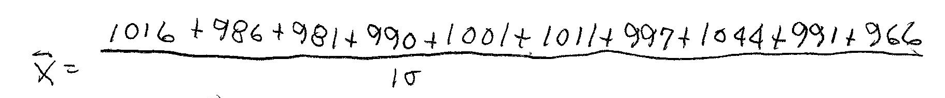
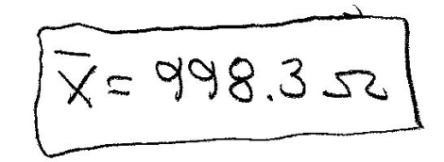
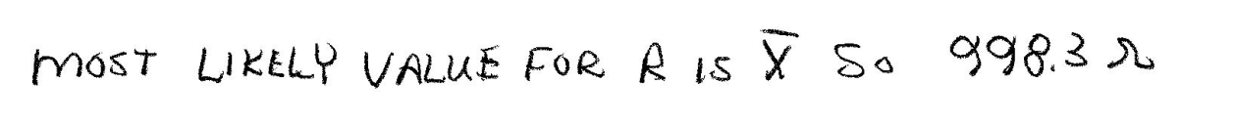
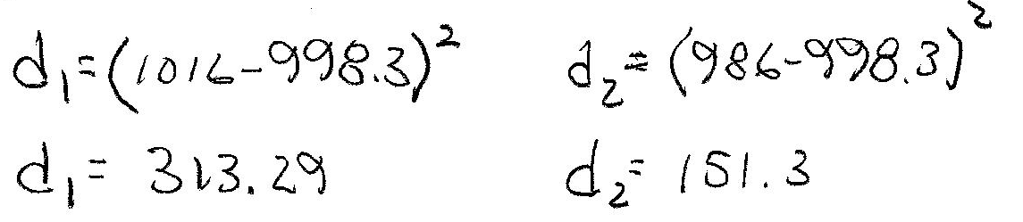
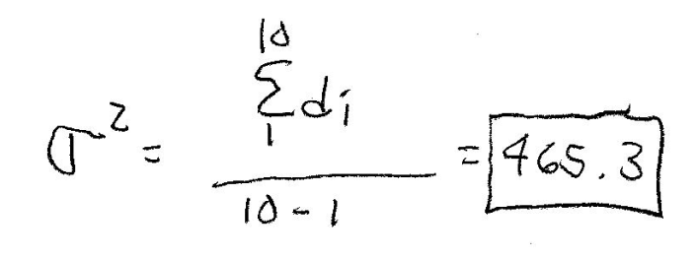
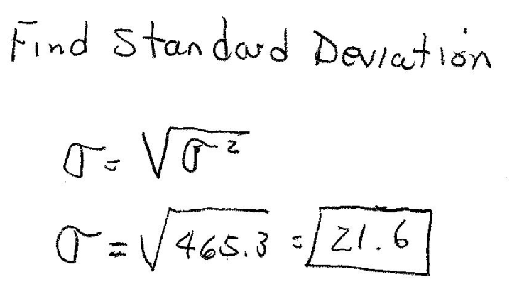
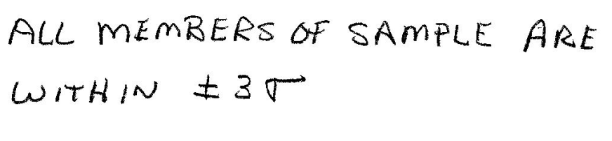
Statistics Example Solution
Variance Calculations

Slide 30
End Lesson 2: Performance of Control Systems
EC311
Linear Control Systems

